Slide 1
PROBABILITY DISTRIBUTIONS

Slide 2

Random Variables
A quantitative variable x is a random variable if the value that it assumes, corresponding to the outcome of an experiment is a chance or random event.
Random variables can be discrete or continuous.
Examples:
  x = SAT score for a randomly selected student
  x = number of people in a room at a randomly selected time of day
  x = number on the upper face of a randomly tossed die

Slide 3
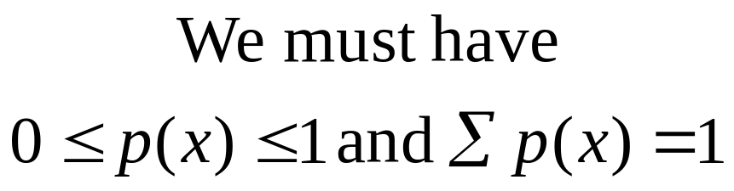
Probability Distributions for Discrete Random Variables
The probability distribution for a discrete random variable x resembles the relative frequency distributions we constructed earlier. It is a graph, table or formula that gives the possible values of x and the probability p(x) associated with each value.

Slide 4
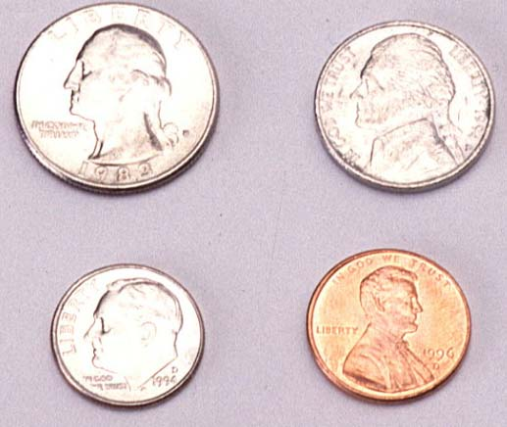
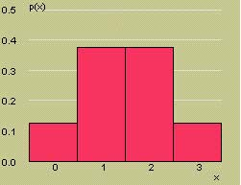
Example
Toss a fair coin three times and define x = number of heads.
x
3
2
2
2
1
1
1
0
HHH
x | p(x)
0 | 1/8
1 | 3/8
2 | 3/8
3 | 1/8
1/8
1/8
1/8
1/8
1/8
1/8
1/8
1/8
P(x = 0) = 1/8
P(x = 1) = 3/8
P(x = 2) = 3/8
P(x = 3) = 1/8
HHT
HTH
THH
HTT
Probability Histogram for x
THT
TTH
TTT

Slide 5
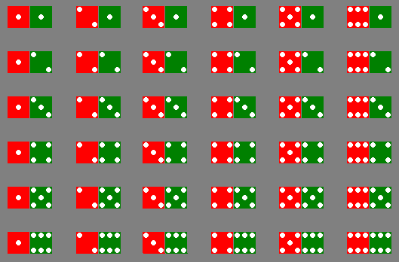
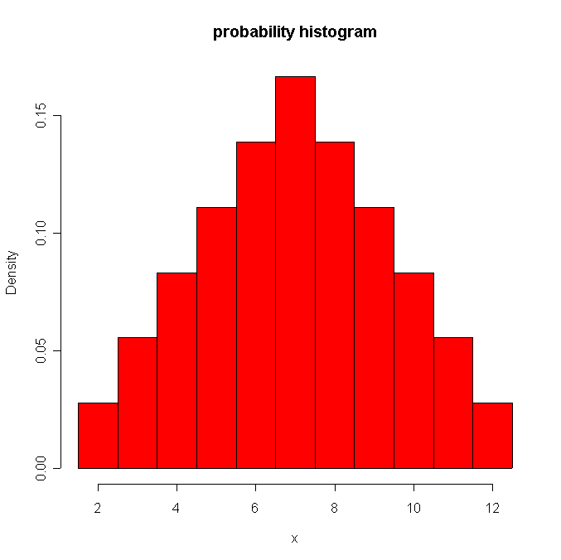
Example
Toss two dice and define
x = sum of two dice.
x | p(x)
2 | 1/36
3 | 2/36
4 | 3/36
5 | 4/36
6 | 5/36
7 | 6/36
8 | 5/36
9 | 4/36
10 | 3/36
11 | 2/36
12 | 1/36

Slide 6
Probability Distributions
Probability distributions can be used to describe the population, just as we described samples earlier.
  Shape: Symmetric, skewed, mound-shaped…
  Outliers: unusual or unlikely measurements
  Center and spread: mean and standard deviation. A population mean is called μ and a population standard deviation is called σ.

Slide 7
Example
The probability distribution for x the number of heads in tossing 3 fair coins.
Symmetric; mound-shaped
Shape?
Outliers?
Center?
Spread?
None
μ = 1.5
σ = .688
μ

Slide 8


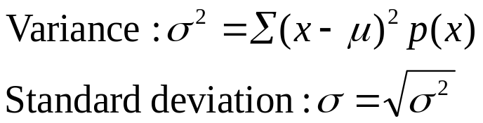
Key Concepts
V. Discrete Random Variables and Probability Distributions
1. Random variables, discrete and continuous
2. Properties of probability distributions
3. Mean or expected value of a discrete random variable:
4. Variance and standard deviation of a discrete random variable:

